Slide 1
DEPARTMENT OF COMPUTER SCIENCE AND ENGINEERING PRINCIPLES OF COMPILER DESIGN
MODULE : I
TOPIC : LEXICAL ANALYSER GENERATOR&PARSER GENERATOR-YACC

Slide 2
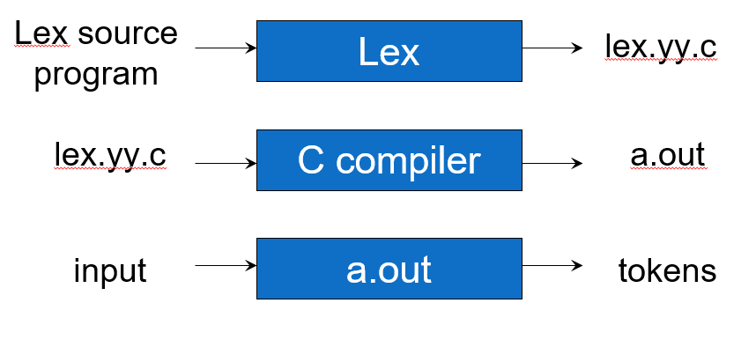
Lexical Analyzer Generator-Lex
Lex is a program designed to generate scanners, also known as tokenizers, which recognize lexical patterns in text.

Slide 3
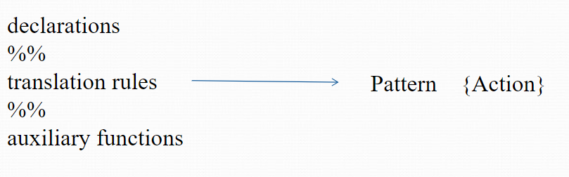
Structure of lex program

Slide 4
Lex Source to C Program
The table is translated to a C program (lex.yy.c) which
reads an input stream
partitioning the input into strings which match the given expressions and
copying it to an output stream if necessary

Slide 5
Lex Specification
A LEX program consists of three parts:
{ declarations }
%%
{ translation rules }
%%
{ user subroutines }

Slide 6
Lex Specification
Definitions include
declarations of variables, constants, and
regular definitions
Rules are statements of the form
p₁ {action₁}
p₂ {action₂}
…
p_{n} {action_{n}}

Slide 7
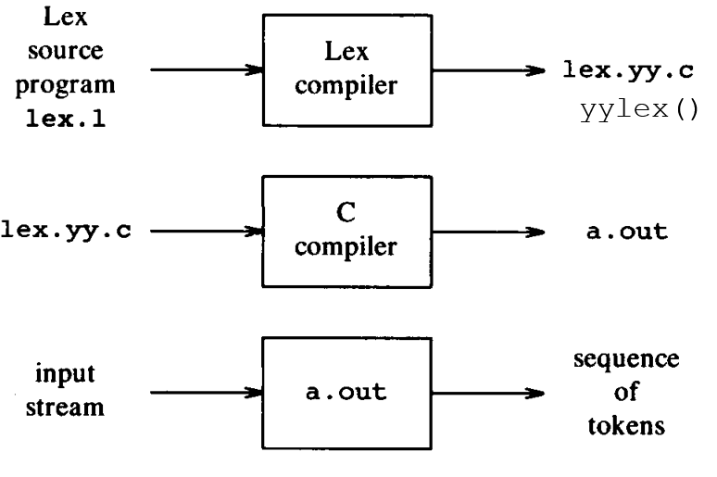
Language for Specifying Lexical Analyzer

Slide 8
Simple Lex Example
int num_lines = 0, num_chars = 0;
%%
\n ++num_lines; ++num_chars;
. ++num_chars;
%%
main()
{
yylex();
printf( "# of lines = %d,
# of chars = %d\n",
num_lines, num_chars );
}

Slide 9
Lex Source
Lex source is separated into three sections by %% delimiters
The general format of Lex source is
The absolute minimum Lex program is thus
{definitions}
%%
{transition rules}
%%
{user subroutines}
(required)
(optional)
%%

Slide 10
Lex vs Yacc
Lex
Lex generates C code for a lexical analyzer, or scanner
Lex uses patterns that match strings in the input and converts the strings to tokens
Yacc
Yacc generates C code for syntax analyzer, or parser.
Yacc uses grammar rules that allow it to analyze tokens from Lex and create a syntax tree.

Slide 11
%{
int c=0,w=0,l=0,s=0;
%}
%%
[\n] l++;s++;
[\t ''] s++;
[^ '' \t \n]+ w++;c+=yyleng;
%%
int main(int argc,char *argv[])
{
if(argc==2)
{
yyin=fopen(argv[1],"r");
yylex();
printf("\nNumber of spaces = %d",s);
printf("\nNumber of characters = %d",c);
printf("\nNumber of lines = %d",l);
printf("\nNumber of words = %d\n",w);
}
else
printf("ERROR");
}
abc.txt
hai
hello
how are you?
Output :
$ lex l1.l
$ cc lex.yy.c -ll
$ ./a.out abc.txt
Number of spaces = 5
Number of characters = 18
Number of lines = 3
Number of words = 5

Slide 12
%{
#include<stdio.h>
%}
letter [a-zA-Z]
digit[0-9]
operators [+*/=%&|<>-]
specialcharacters [();{}"]
%%
(#include<stdio.h>|void|main|int|float|char|printf|while|do|for|if|else|double|break|continue|scanf|switch|case)+ {printf(" Keyword ");}
{letter}({letter}|{digit})* {printf(" Variable ");}
{digit}+ {printf(" Number ");}
{operators}+ {printf(" Operator ");}
{specialcharacters}+ {printf(" Specialcharacter ");}
%%
int main(int argc,char *argv[])
{
yyin = fopen(argv[1],"r");
yylex();
}
abc.c
#include<stdio.h>
void main()
{
a=b+3;
printf("Hello world");
}
Output :
$ lex l2.l
$ cc lex.yy.c -ll
$ ./a.out abc.c
Keyword
Keyword Keyword Special character
Special character
Variable Operator Variable Operator Number Special character
Keyword Special character Variable Variable Special character

Slide 13
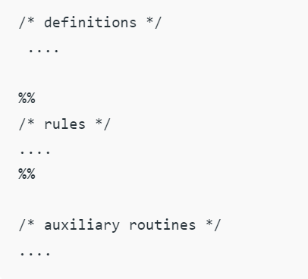
YACC-Parser Generator
A parser generator is a program that takes as input a specification of a syntax, and produces as output a procedure for recognizing that language.
Historically, they are also called compiler-compilers. YACC (yet another compiler-compiler) is an LALR(1) (LookAhead, Left-to-right, Rightmost derivation producer with 1 lookahead token) parser generator.
YACC was originally designed for being complemented by Lex.

Slide 14
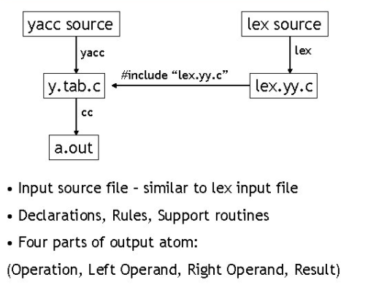
YACC- Parser Generator

Slide 15
Lex with Yacc
Lex source
(Lexical Rules)
Yacc source
(Grammar Rules)
Lex
Yacc
lex.yy.c
y.tab.c
call
yylex()
yyparse()
Parsed
Input
Input
return token

Slide 16
Design of a parser generator.
gram.y
File containing desired
grammar in yacc format
yacc
yacc program
y.tab.c
C source program created by yacc
cc
or gcc
C compiler
a.out
Executable program that will parse
grammar given in gram.y

Slide 17
How YACC Works
y.tab.h
yacc
YACC source (*.y)
y.tab.c
y.output
(1) Parser generation time
C compiler/linker
y.tab.c
a.out
(2) Compile time
a.out
Abstract
Syntax
Tree
Token stream
(3) Run time

Slide 18

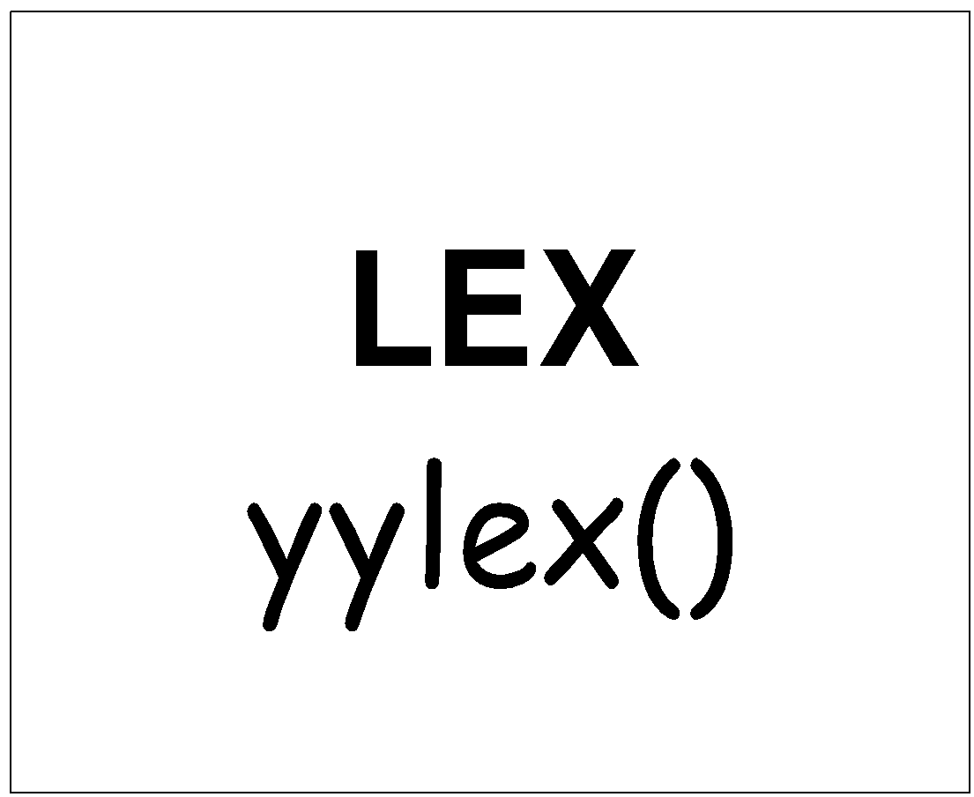
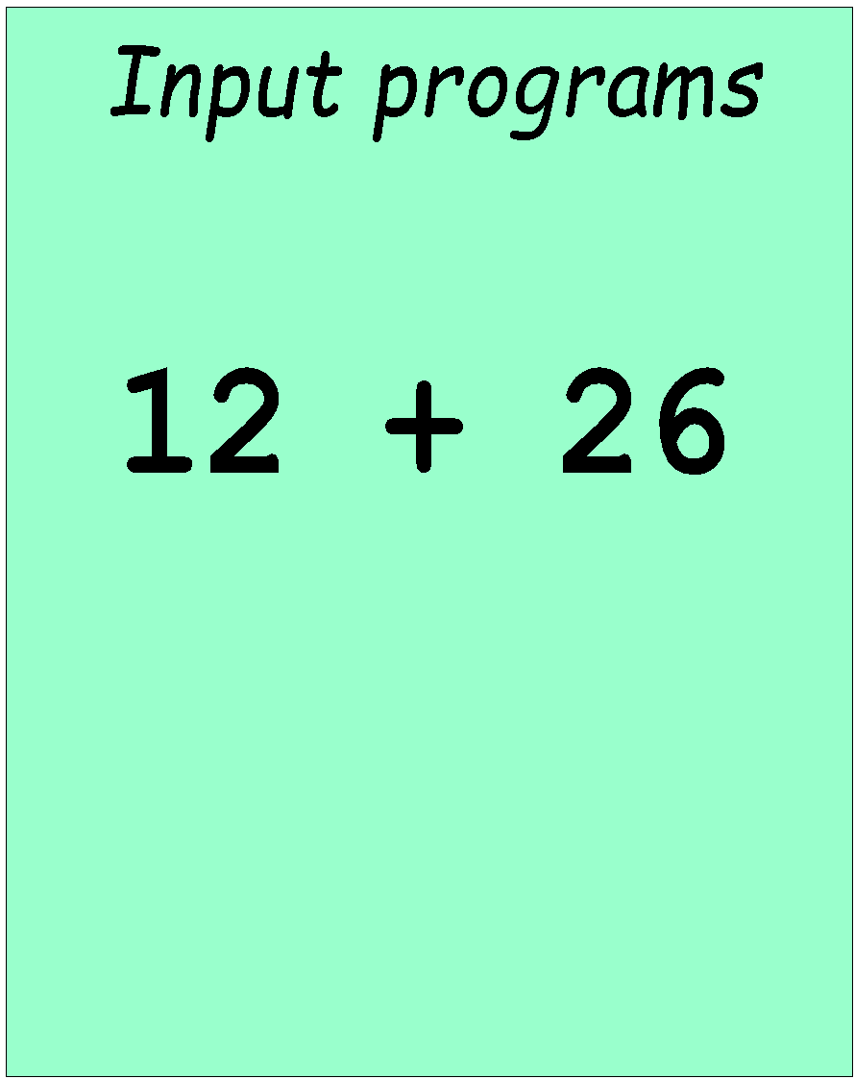
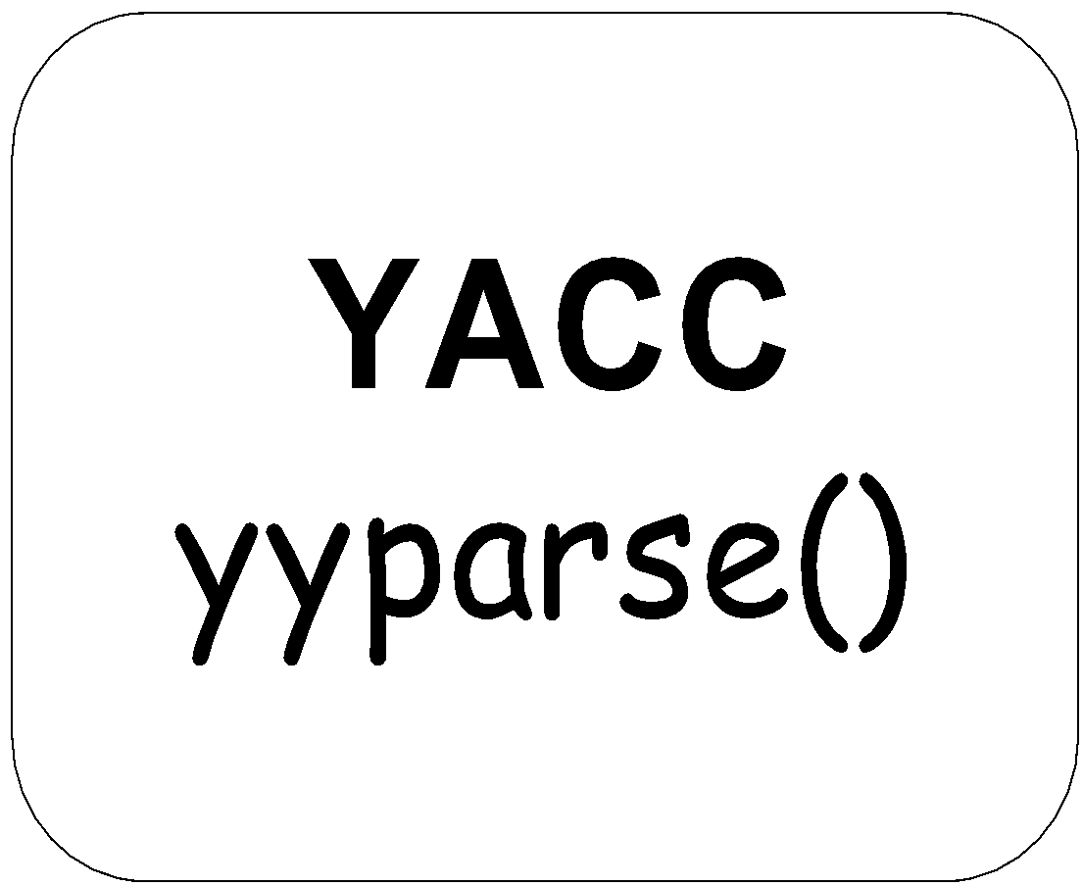
Works with Lex
How to work ?

Slide 19
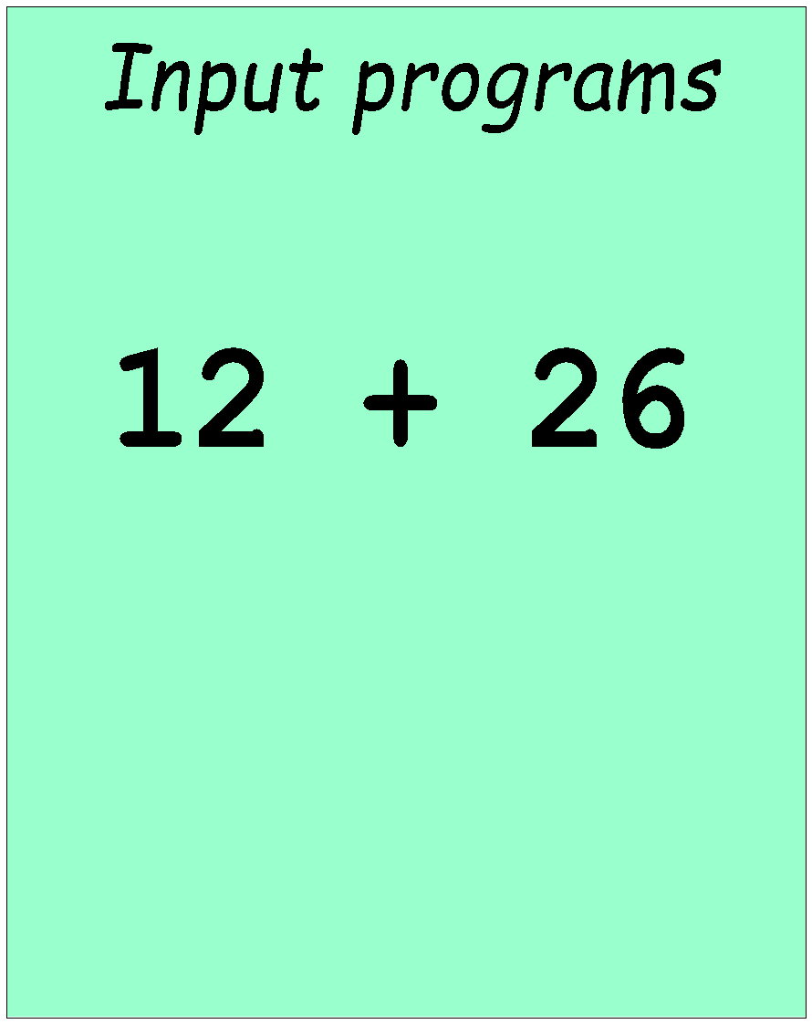
Works with Lex
[0-9]+
call yylex()
next token is NUM
NUM ‘+’ NUM

Slide 20
YACC File Format
%{
C declarations
%}
yacc declarations
%%
Grammar rules
%%
Additional C code
Comments enclosed in /* ... */ may appear in any of the sections.

Slide 21
Definition Section
%{
#include <stdio.h>
#include <stdlib.h>
%}
%token ID NUM
%start expr
It is a terminal

Slide 22
Start Symbol
The first non-terminal specified in the grammar specification section.
To overwrite it with %start declaraction.
%start non-terminal

Slide 23
yacc1.y
%{
#include<stdio.h>
%}
%token NAME NUMBER
%%
stmt:S {printf("SUCCESS\n");}
S : '('L')'{}
|NAME{}
|NUMBER{}
;
L : L','S{}
|S{}
;
%%
int main(void)
{
return yyparse();
}
int yyerror(char *msg)
{
return fprintf(stderr,"YACC:%s\n",msg);
}
lexx1.l
%{
#include "y.tab.h"
extern int yylval;
%}
%%
[0-9]+ {yylval=atoi(yytext);
printf("Scanned the number %d\n",yylval);
return NUMBER;}
[a-zA-Z]+ {printf("Scanned a name\n");
return NAME;}
[\t] {printf("Skipped whitespace\n");}
\n {return 0;}
{printf("Found other data \"%s\"\n",yytext);
return yytext[0];
}
%%

Slide 24
$ ./a.out
(id))
Found other data "("
Scanned a name
Found other data ")"
SUCCESS
Found other data ")"
YACC:syntax error
$ lex lexx1.l
$ yacc -d yacc1.y
$ cc lex.yy.c y.tab.c -ll
$ ./a.out
(id,(id,1))
Found other data "("
Scanned a name
Found other data ","
Found other data "("
Scanned a name
Found other data ","
Scanned the number 1
Found other data ")"
Found other data ")"
SUCCESS

Slide 25
yacc2.y
%{
#include<stdio.h>
%}
%token NAME NUMBER
%%
stmt:E {printf("SUCCESS\n");}
E : E'+'T{}
|T
;
T : T'*'F{}
|F
;
F : '('E')'{}
|NAME{}
|NUMBER{}
;
%%
int main(void)
{
return yyparse();
}
int yyerror(char *msg)
{
return fprintf(stderr,"YACC:%s\n",msg);
}
lexx2.l
%{
#include "y.tab.h"
extern int yylval;
%}
%%
[0-9]+ {yylval=atoi(yytext);
printf("Scanned the number %d\n",yylval);
return NUMBER;}
[a-zA-Z]+ {printf("Scanned a name\n");
return NAME;}
[\t] {printf("Skipped whitespace\n");}
\n {return 0;}
. {printf("Found other data \"%s\"\n",yytext);
return yytext[0];
}
%%

Slide 26
$ ./a.out
id*
Scanned a name
Found other data "*"
YACC:syntax error
OUTPUT :
$ lex lexx2.l
$ yacc -d yacc2.y
$ cc lex.yy.c y.tab.c -ll
$ ./a.out
id*id+id
Scanned a name
Found other data "*"
Scanned a name
Found other data "+"
Scanned a name
SUCCESS

Slide 27
THANK YOU

